Slide 1
CSP571 Data Preparation and Analysis
Lecture 16. Visualizing Deep Learning Networks
Oleksandr Narykov
onarykov@iit.edu
Partially based on 10.23915/distill.00024.007 and
Protopapas, Glickman, Tanner lecture

Slide 2
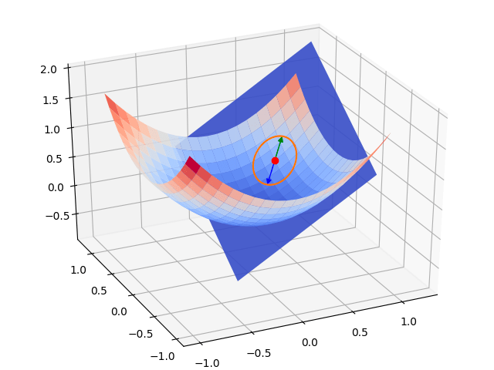
Loss Landscapes
Directly visualizing loss function along with its gradients
https://arxiv.org/pdf/1712.09913

Slide 3
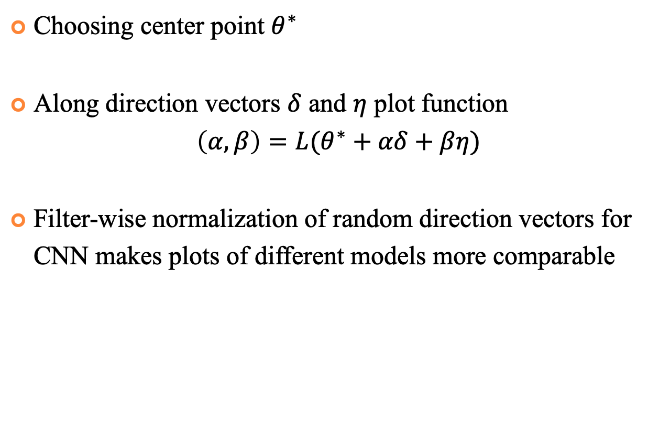
Loss Landscapes
Choosing center point $θ^{∗}$
Along direction vectors $δ$ and $η$ plot function
$$\left(α,β\right)=L(θ^{∗}+αδ+βη)$$
Filter-wise normalization of random direction vectors for CNN makes plots of different models more comparable

Slide 4
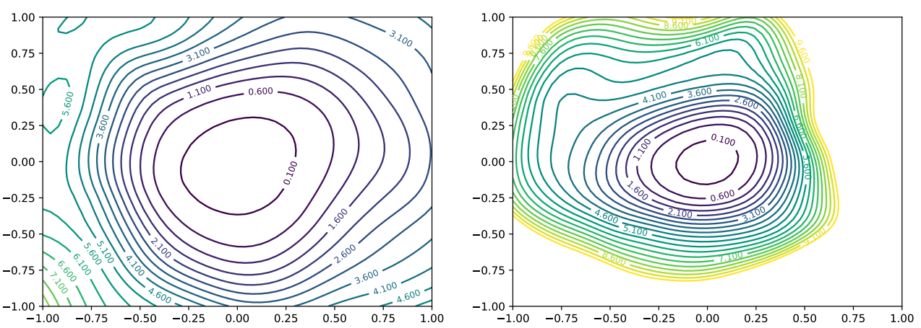
Loss Landscapes
Loss landscape for different sets of parameters
https://arxiv.org/pdf/1712.09913

Slide 5
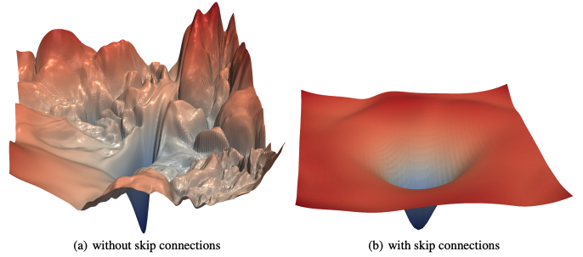
Loss Landscapes
Loss surface of ResNet-56 with and without skip connections
https://arxiv.org/pdf/1712.09913

Slide 6
Visualizing Weights
Activations
Weights
Attribution
Notes:
Activations: We generally think of these as being “what” the network saw. If understanding a neural network is like reverse compiling a computer program, the neurons are the variables, and the activations are the values of those variables.
Weights: We generally think of these as being “how” the neural network computes one layer from the previous one. In the reverse engineering analogy, these are compiled assembly instructions.
Attributions: Attributions try to tell us the extent to which one neuron influenced a later neuron.[2, 3]
We often think of this as “why” the neuron fired. We need to be careful with attributions, because they’re a human-defined object on top of a neural network rather than a fundamental object. They aren’t always well defined, and people mean different things by them. (They are very well defined if you are only operating across adjacent layers!)

Slide 7
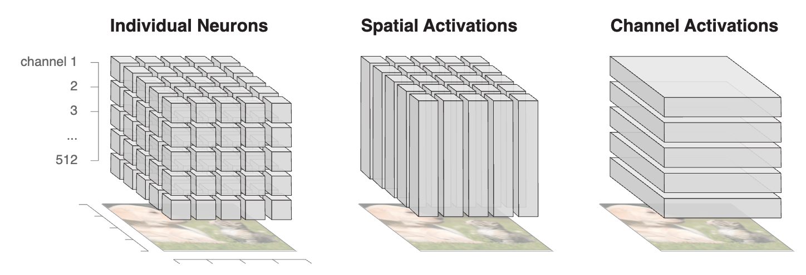
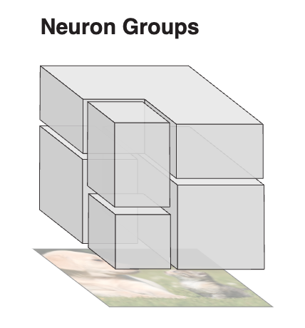
Hidden Layers
Notes:
Interpretability methods often fail to take off because they’re hard to use. So before diving into sophisticated approaches, we wanted to offer a simple, easy to apply method.
In a convolutional network, the input weights for a given neuron have shape [width, height, input_channels]. Unless this is the first convolutional layer, this probably can’t be easily visualized because input_channels is large. (If this is the first convolutional layer, visualize it as is!) However, one can use dimensionality reduction to collapse input_channels down to 3 dimensions. We find one-sided NMF especially effective for this.
NMF was first introduced by Paatero andTapper in 1994, and popularised in a article by Lee and Seung in 1999. Since then, the number of publications referencing the technique has grown rapidly

Slide 8
Challenges
Lack of Contextualization
Indirect Interaction
Dimensionality and Scale
Notes:
Lack of Contextualization: Researchers often visualize weights in the first layer, because they are linked to RGB values that we understand. That connection makes weights in the first layer meaningful. But weights between hidden layers are meaningless by default: knowing nothing about either the source or the destination, how can we make sense of them?
Indirect Interaction: Sometimes, the meaningful weight interactions are between neurons which aren’t literally adjacent in a neural network. For example, in a residual network, the output of one neuron can pass through the additive residual stream and linearly interact with a neuron much later in the network. In other cases, neurons may interact through intermediate neurons without significant nonlinear interactions. How can we efficiently reason about these interactions?
Dimensionality and Scale: Neural networks have lots of neurons. Those neurons connect to lots of other neurons. There’s a lot of data to display! How can we reduce it to a human-scale amount of information?

Slide 9
Simple Approach – Dimensionality Reduction
Applying Non-negative Matrix Factorization (NMF)
Convolution-specific
4 | 3 | 7 | 1
8 | 5 | 6 | 4
8 | 4 | 3 | 6
3 | 4 | 7 | 3
4 | 3 | 7 | 1
8 | 5 | 6 | 4
8 | 4 | 3 | 6
3 | 4 | 7 | 3
1 | 0
2 | 1
4 | 3 | 7 | 1
8 | 5 | 6 | 4
8 | 4 | 3 | 6
3 | 4 | 7 | 3
1 | 3
-1 | 1
1 | -1
-1 | 1
1 | 0
2 | 1
1 | 3
-1 | 1
1 | -1
-1 | 1
1 | 0
2 | 1
1 | 3
-1 | 1
1 | -1
-1 | 1
Image
Kernels
Feature Maps
Notes:
Interpretability methods often fail to take off because they’re hard to use. So before diving into sophisticated approaches, we wanted to offer a simple, easy to apply method.
In a convolutional network, the input weights for a given neuron have shape [width, height, input_channels]. Unless this is the first convolutional layer, this probably can’t be easily visualized because input_channels is large. (If this is the first convolutional layer, visualize it as is!) However, one can use dimensionality reduction to collapse input_channels down to 3 dimensions. We find one-sided NMF especially effective for this.
NMF was first introduced by Paatero andTapper in 1994, and popularised in a article by Lee and Seung in 1999. Since then, the number of publications referencing the technique has grown rapidly

Slide 10
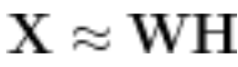
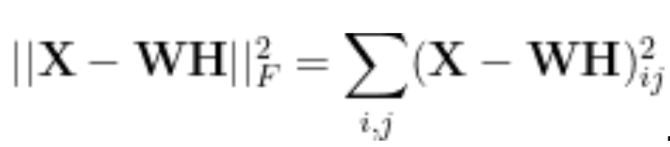
NMF
Notes:
NMF approximates a matrix with a low-rank matrix approximation such that .
For the discussion in this paper, we’ll assume that is set up so that there are data points each with dimensions, and every column of is a data point, i.e. .

Slide 11
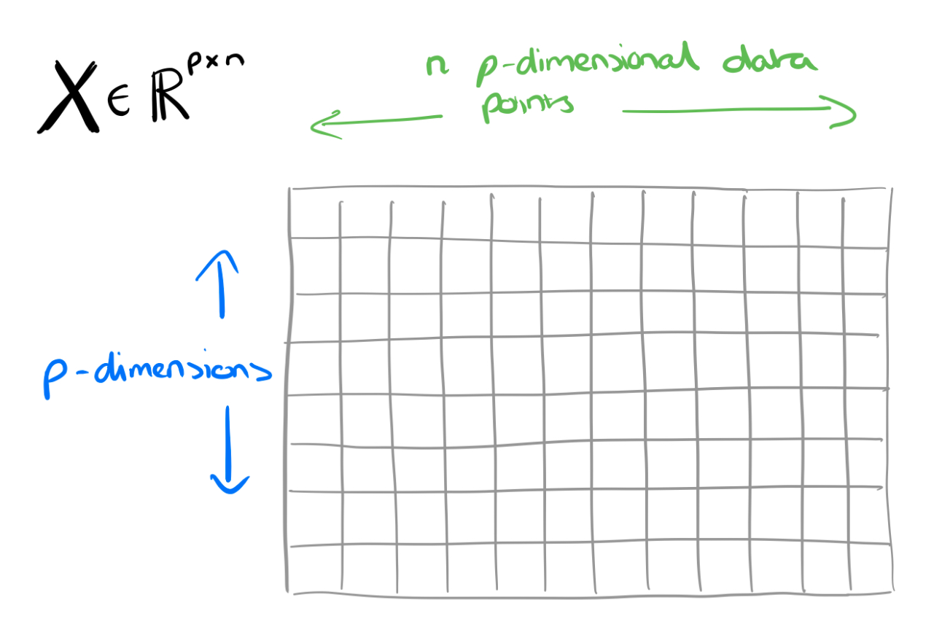
NMF
https://blog.acolyer.org/2019/02/18/the-why-and-how-of-nonnegative-matrix-factorization/
Notes:
Interpretability methods often fail to take off because they’re hard to use. So before diving into sophisticated approaches, we wanted to offer a simple, easy to apply method.
In a convolutional network, the input weights for a given neuron have shape [width, height, input_channels]. Unless this is the first convolutional layer, this probably can’t be easily visualized because input_channels is large. (If this is the first convolutional layer, visualize it as is!) However, one can use dimensionality reduction to collapse input_channels down to 3 dimensions. We find one-sided NMF especially effective for this.
NMF was first introduced by Paatero andTapper in 1994, and popularised in a article by Lee and Seung in 1999. Since then, the number of publications referencing the technique has grown rapidly

Slide 12
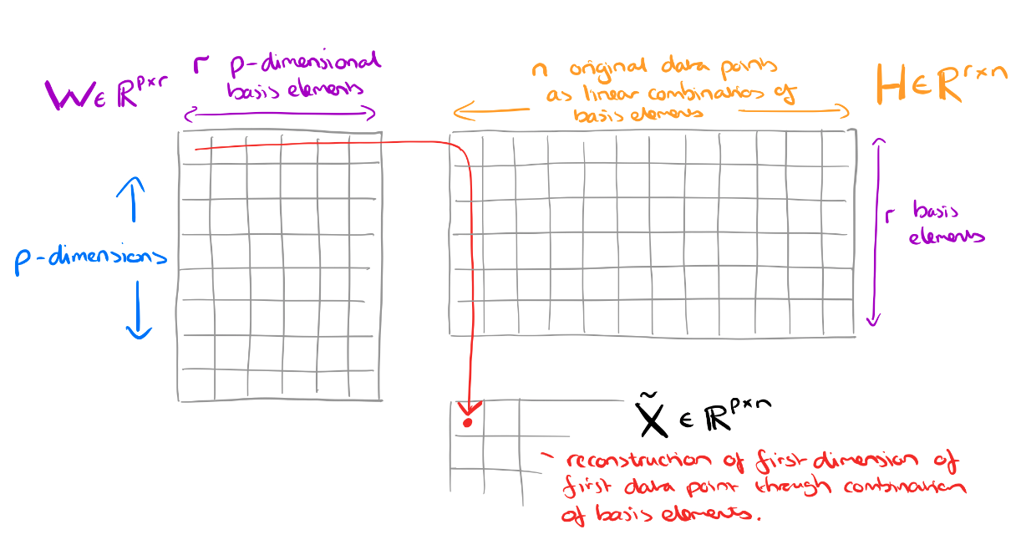
NMF
https://blog.acolyer.org/2019/02/18/the-why-and-how-of-nonnegative-matrix-factorization/
Notes:
We want to reduce the original dimensions to (aka, create a rank approximation). So we’ll have and .
The interpretation of is that each column is a basis element. By basis element we mean some component that crops up again and again in all of the original data points. These are the fundamental building blocks from which we can reconstruct approximations to all of the original data points.
The interpretation of is that each column gives the ‘coordinates of a data point’ in the basis . In other words, it tells you how to reconstruct an approximation to the original data point from a linear combination of the building blocks in

Slide 13
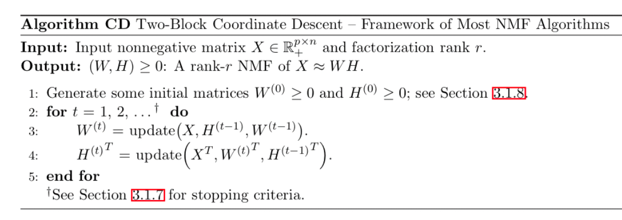
NMF
https://arxiv.org/abs/1401.5226
Notes:
Almost all NMF algorithms use a two-block coordinate descent scheme (exact or inexact), that is, they optimize alternatively over one of the two factors, W or H, while keeping the other fixed. The reason is that the subproblem in one factor is convex. More precisely, it is a nonnegative least squares problem (NNLS). Many algorithms exist to solve the NNLS problem; and NMF algorithms based on two-block coordinate descent differ by which NNLS algorithm is used.

Slide 14
NMF
Pros:
Simplicity
Works well in most practical applications
Cons:
NP-hard
The existence of a single unique decomposition is not guaranteed
Difficult to choose factorization rank

Slide 15
NMF
Recommendations:
Study data with clustering approaches
Use Singular Value Decomposition (SVD) for initialization
Notes:
You can initialise W and H randomly, but there are also alternate strategies designed to give better initial estimates in the hope of converging more rapidly to a good solution:
Use some clustering method, and make the cluster means of the top r clusters as the columns of W, and H as a scaling of the cluster indicator matrix (which elements belong to which cluster).
Finding the best rank-r approximation of X using SVD and using this to initialise W and H (see section 3.1.8)
Picking r columns of X and just using those as the initial values for W.

Slide 16
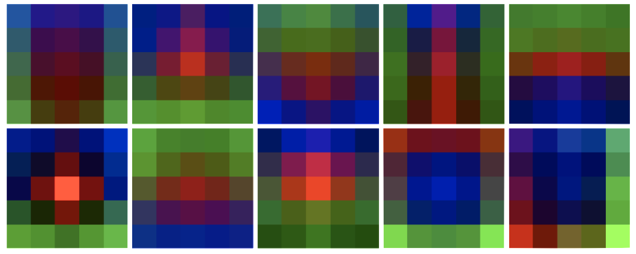
Applying NMF to NN Weights
Convolution-specific
Lacks context
NMF of input weights in InceptionV1 mixed4d_5x5, for a selection of ten neurons. The red, green, and blue channels on each grid indicate the weights for each of the 3 NMF factors.
Notes:
This visualization doesn’t tell you very much about what your weights are doing in the context of the larger model, but it does show you that they are learning nice spatial structures. This can be an easy sanity check that your neurons are learning, and a first step towards understanding your neuron’s behavior. We’ll also see later that this general approach of factoring weights can be extended into a powerful tool for studying neurons.
Despite this lack of contextualization, one-sided NMF can be a great technique for investigating multiple channels at a glance. One thing you may quickly discover using this method is that, in models with global average pooling at the end of their convolutional layers, the last few layers will have all their weights be horizontal bands.

Slide 17
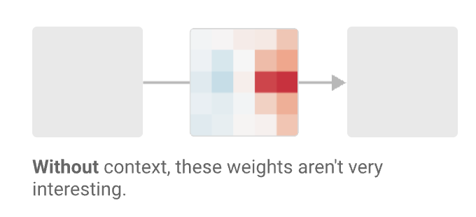
Contextualizing Weights with Feature Visualization
CNN weights:
[relative x position, relative y position, input channels, output channels]
Visualize [width, height] matrix
Notes:
Of course, looking at weights in a vacuum isn’t very interesting. In order to really understand what’s going on, we need to contextualize weights in the broader context of the network. The challenge of contextualization is a recurring challenge in understanding neural networks: we can easily observe every activation, every weight, and every gradient; the challenge lies in determining what those values represent.

Slide 18
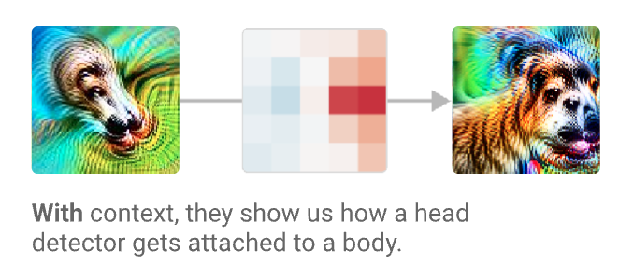
Contextualizing Weights with Feature Visualization
CNN weights:
[relative x position, relative y position, input channels, output channels]
Visualize [width, height] matrix
Notes:
We can liken this to how, when reverse-engineering a normal compiled computer program, one would need to start assigning variable names to the values stored in registers to keep track of them. Feature visualizations are essentially automatic variable names for neurons, which are roughly analogous to those registers or variables.
If we fix the input channel and the output channel, we get a 2D array we can present with traditional data visualization. Let’s assume we know which neuron we’re interested in understanding, so we have the output channel. We can pick the input channels with high magnitude weights to our output channel.
But what does the input represent? What about the output?
The key trick is that techniques like feature visualization (or deeper investigations of neurons) can help us understand what the input and output neurons represent, contextualizing the graph. Feature visualizations are especially attractive because they’re automatic, and produce a single image which is often very informative about the neuron. As a result, we often represent neurons as feature visualizations in weight diagrams.

Slide 19
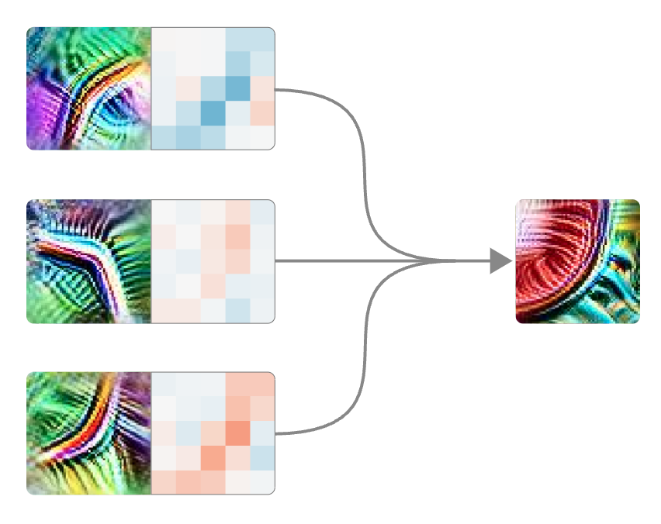
Contextualizing Weights. Small Multiples
Small multiple weights for mixed3b 342.
Notes:
We can liken this to how, when reverse-engineering a normal compiled computer program, one would need to start assigning variable names to the values stored in registers to keep track of them. Feature visualizations are essentially automatic variable names for neurons, which are roughly analogous to those registers or variables.

Slide 20
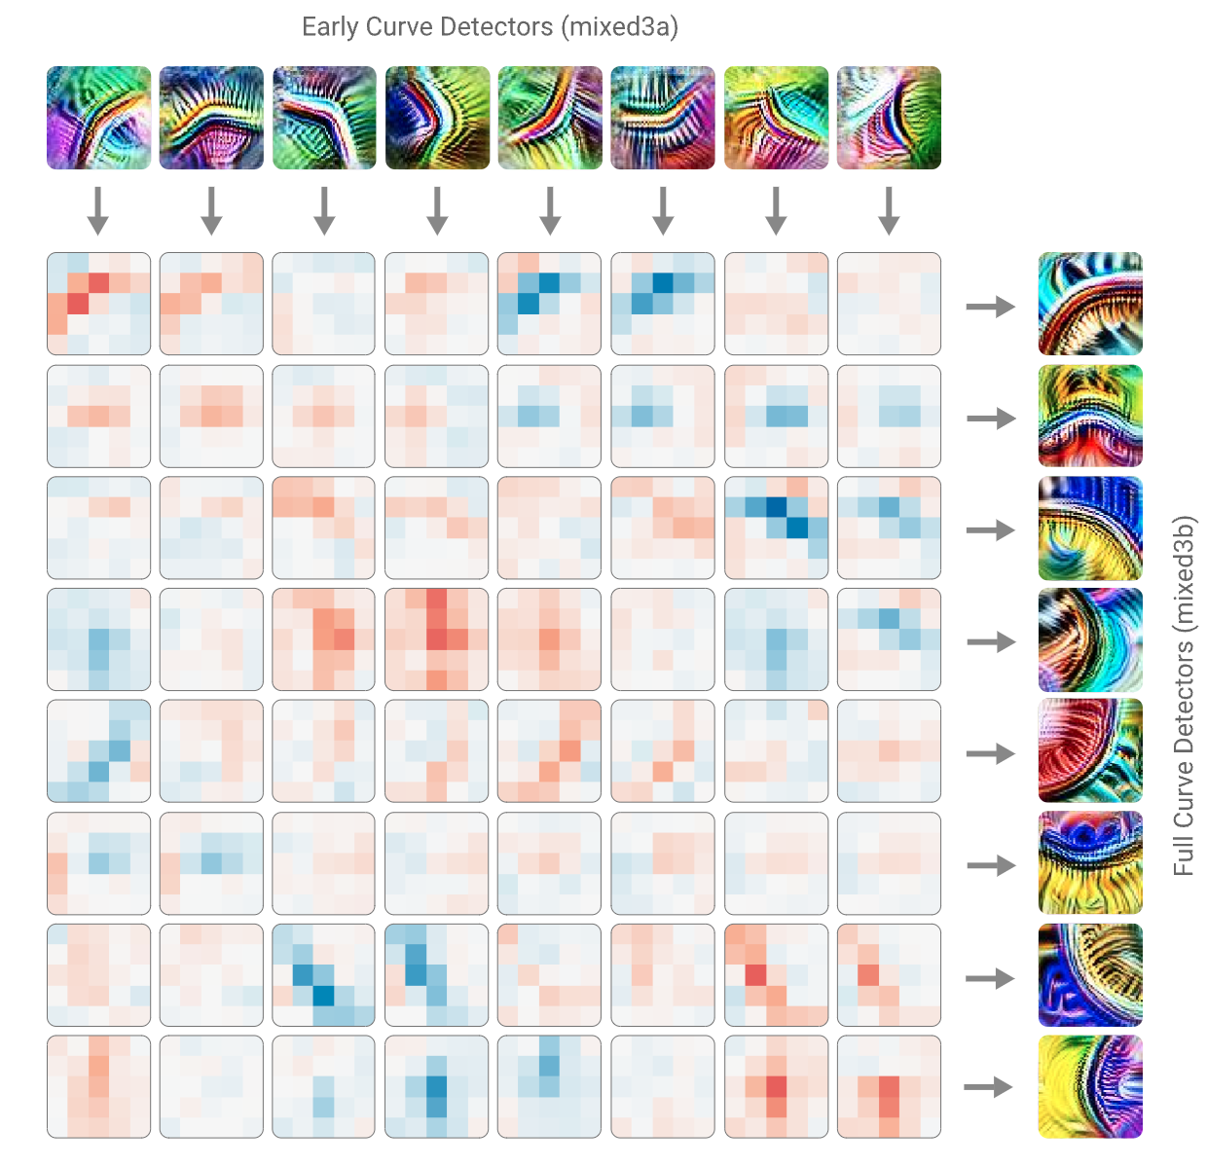
Contextualizing Weights. Small Multiples
Small multiple weights for curve detectors
Notes:
We can liken this to how, when reverse-engineering a normal compiled computer program, one would need to start assigning variable names to the values stored in registers to keep track of them. Feature visualizations are essentially automatic variable names for neurons, which are roughly analogous to those registers or variables.

Slide 21
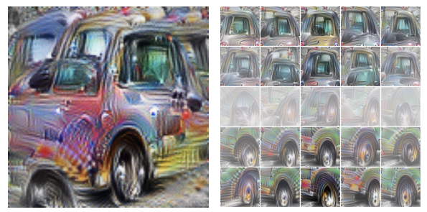
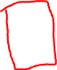
Contextualizing Weights. Spatial Position Weights
Left: Feature visualization of a car neuron. Right: Feature visualizations of the vector over input neurons at each spatial position of the car neuron’s weights.
Notes:
An alternative approach is to think of there as being a vector over input neurons at each spatial position and to apply feature visualization to each of those vectors. You can think of this as telling us what the weights in that position are collectively looking for.
As we see, the car neuron broadly responds to window features above wheel features.

Slide 22
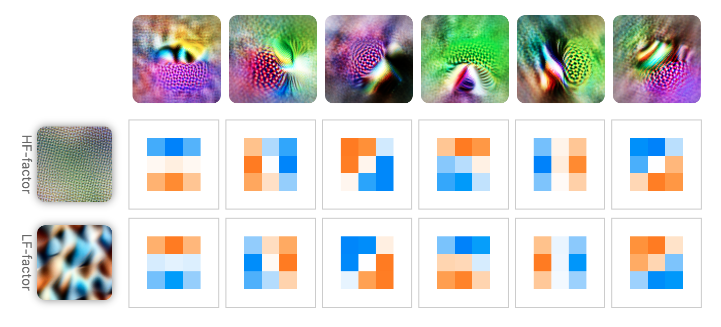
Contextualizing Weights. Weight Factors
NMF factorization on the weights (excitatory and inhibitory) connecting six high-low frequency detectors in InceptionV1 to the layer conv2d2.
Notes:
Feature visualization can also be applied to factorizations of the weights
Combining High-Frequency factor and Low-Frequency factor

Slide 23
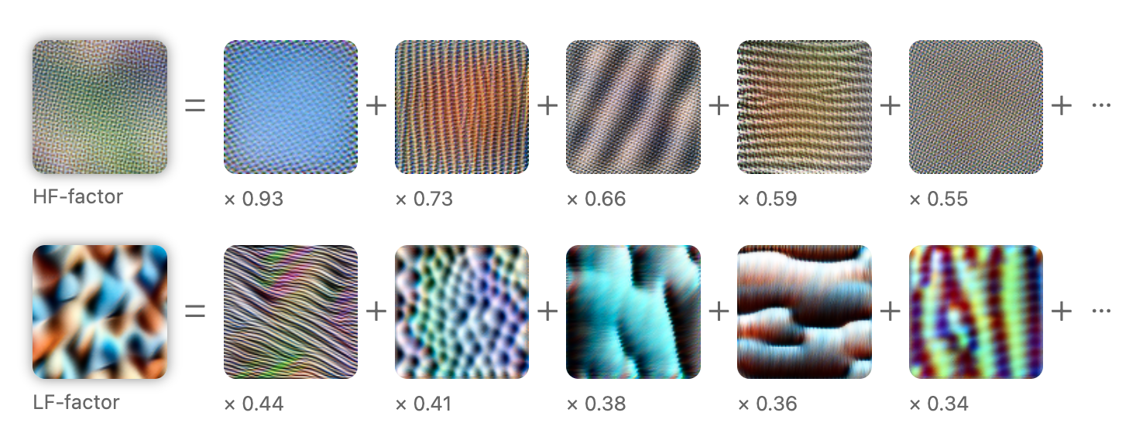
Contextualizing Weights. Weight Factors
Neurons (by their feature visualizations) that contribute to the two NMF factors
Notes:
Feature visualization can also be applied to factorizations of the weights
Combining High-Frequency factor and Low-Frequency factor

Slide 24
Contextualizing Weights. Indirect Interactions
Neurons (by their feature visualizations) that contribute to the two NMF factors
Notes:
Feature visualization can also be applied to factorizations of the weights
Combining High-Frequency factor and Low-Frequency factor

Slide 25
Saliency Maps
We want to understand what made my network give a certain class as output.
Saliency Maps, are a way to measure the spatial support of a particular class in each image.
“Find me pixels responsible for the class C having score S(C) when the image I is passed through my network”.
Notes:
Feature visualization can also be applied to factorizations of the weights
Combining High-Frequency factor and Low-Frequency factor

Slide 26
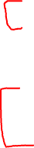
Saliency Maps
Methods:
Gradient Based Backpropagation, Symonian et al. 2013
Deconvolutional Networks, Zeiler and Fergus 2013
Guided Backpropagation Algorithm, Springenberg et al. 2014
Class Activation Maps, Zhou et al. 2016
Grad-CAM and Guided Grad-CAM, Selvaraju et al. 2016
Notes:
Feature visualization can also be applied to factorizations of the weights
Combining High-Frequency factor and Low-Frequency factor

Slide 27
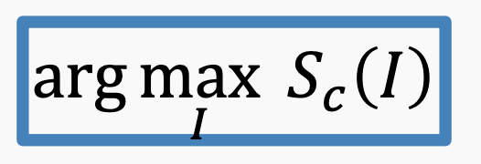
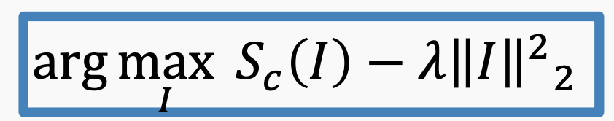
Gradient Based Backpropagation
For an image I, a class c, and a classification ConvNet with the class score function S(I), we would like to rank the pixels of I based on their influence on the score S(I).
Regularize on image norm:
Notes:
Feature visualization can also be applied to factorizations of the weights
Combining High-Frequency factor and Low-Frequency factor

Slide 28
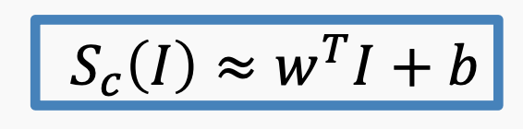
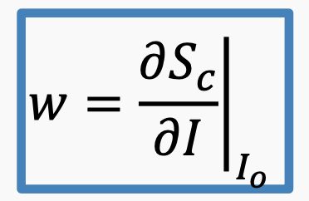
Gradient Based Backpropagation
Use the backpropagation algorithm to compute the gradients of logits w.r.t. to the input of the network while the weights are fixed (for training the network, the gradients are computed w.r.t. the parameters of the network). Using Taylor expansions, we can show that:
Notes:
Using backpropagation, we can highlight pixels of the input image based on the amount of the gradient they receive, which shows their contribution to the final score.

Slide 29
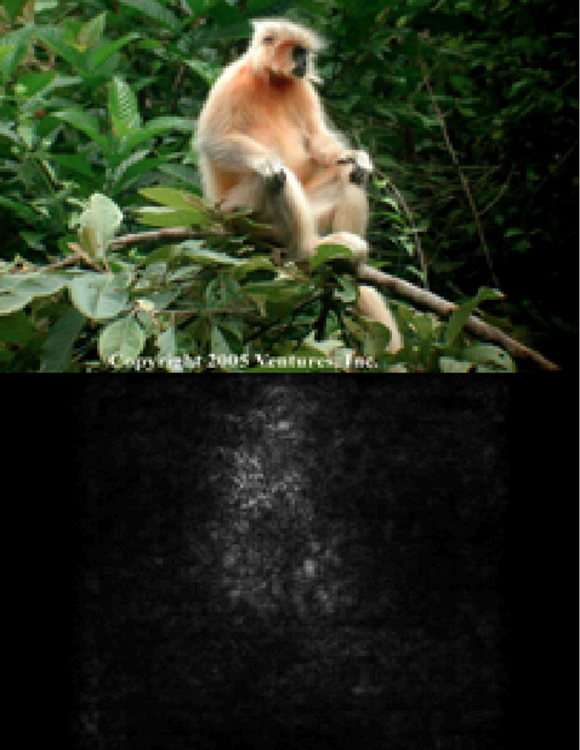
Gradient Based Backpropagation
Notes:
The maps were extracted using a single back-propagation pass through a classification ConvNet. No additional annotation (except for the image labels) was used in training. Note: For color images like the one shown here, we take the maximum derivative of the three derivatives

Slide 30
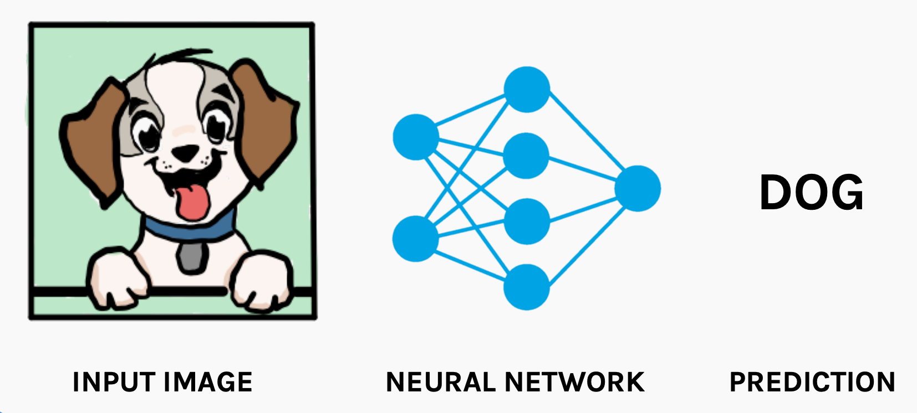
Class Activation Mapping (CAM)
Notes:
An image classification CNN takes an input image and outputs the image label. We want the know what part of the image the model is “looking” at, while making the prediction?

Slide 31
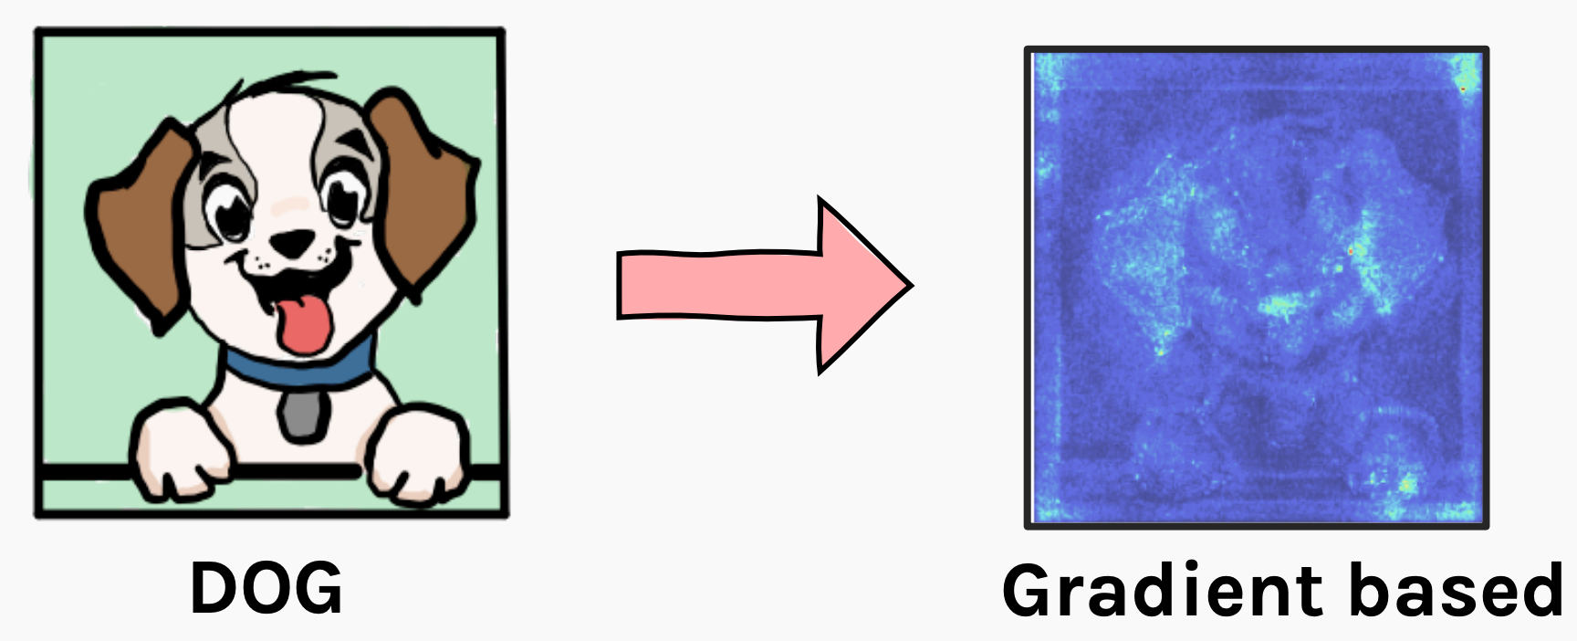
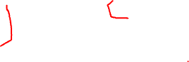
Class Activation Mapping (CAM)
Notes:
An image classification CNN takes an input image and outputs the image label. We want the know what part of the image the model is “looking” at, while making the prediction?

Slide 32
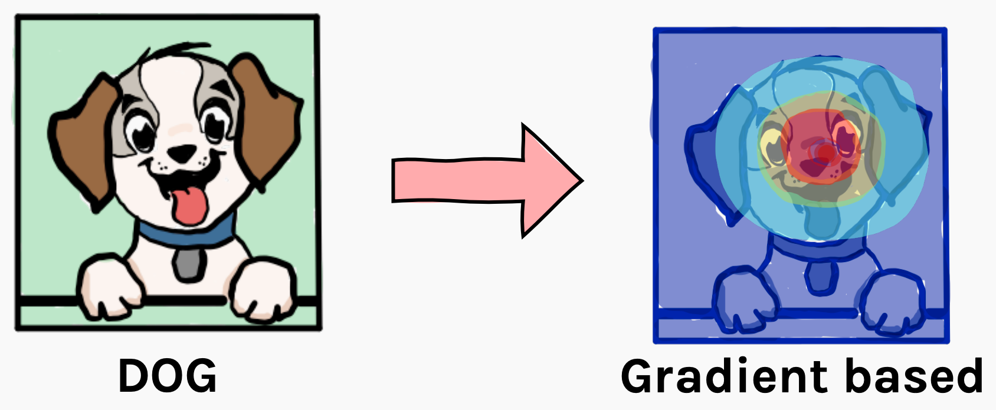
Class Activation Mapping (CAM)
Notes:
A method to estimate which sub-part of the image the model focuses at when making a particular prediction. For example, Dog in the above image.

Slide 33
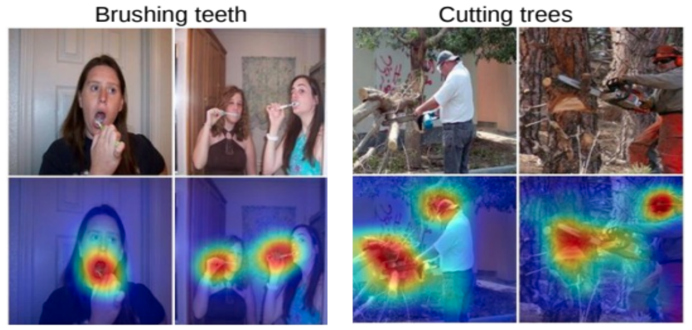
Class Activation Mapping (CAM)
A network where the fully connected layers at the very end of the model have been replaced by a layer named Global Average Pooling (GAP) and combined with a class activation mapping (CAM) technique
Notes:
A method to estimate which sub-part of the image the model focuses at when making a particular prediction. For example, Dog in the above image.

Slide 34
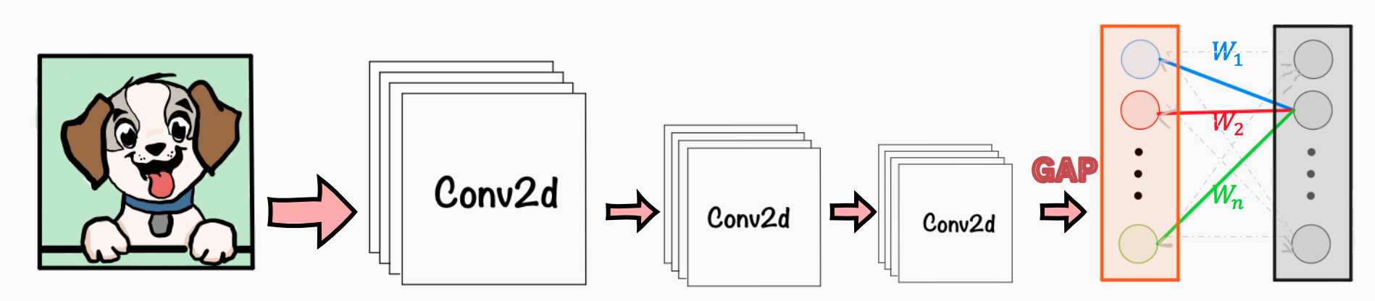
Class Activation Mapping (CAM)
Instead of Dense layer, we use a Global Average Pooling (GAP) to average the activations of each feature map
Each of the averages is concatenated into a single vector (shown in color red below)
Then, a weighted sum of the resulting vector is fed to the final softmax loss layer.
Notes:
A method to estimate which sub-part of the image the model focuses at when making a particular prediction. For example, Dog in the above image.

Slide 35
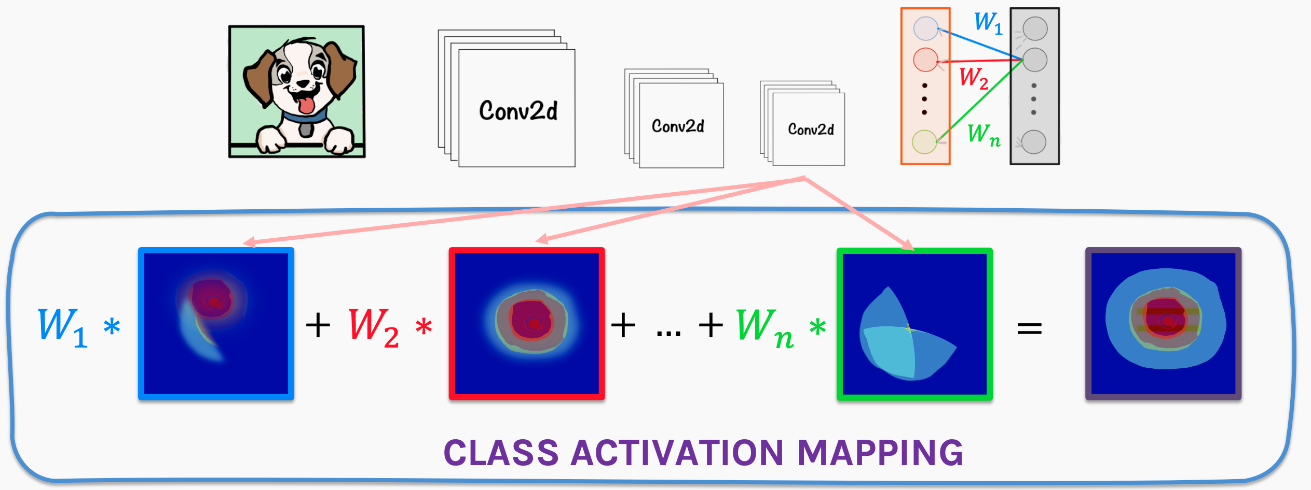
Class Activation Mapping (CAM)
For a particular prediction, we take the weighted sum of the feature maps
Notes:
A method to estimate which sub-part of the image the model focuses at when making a particular prediction. For example, Dog in the above image.

Slide 36
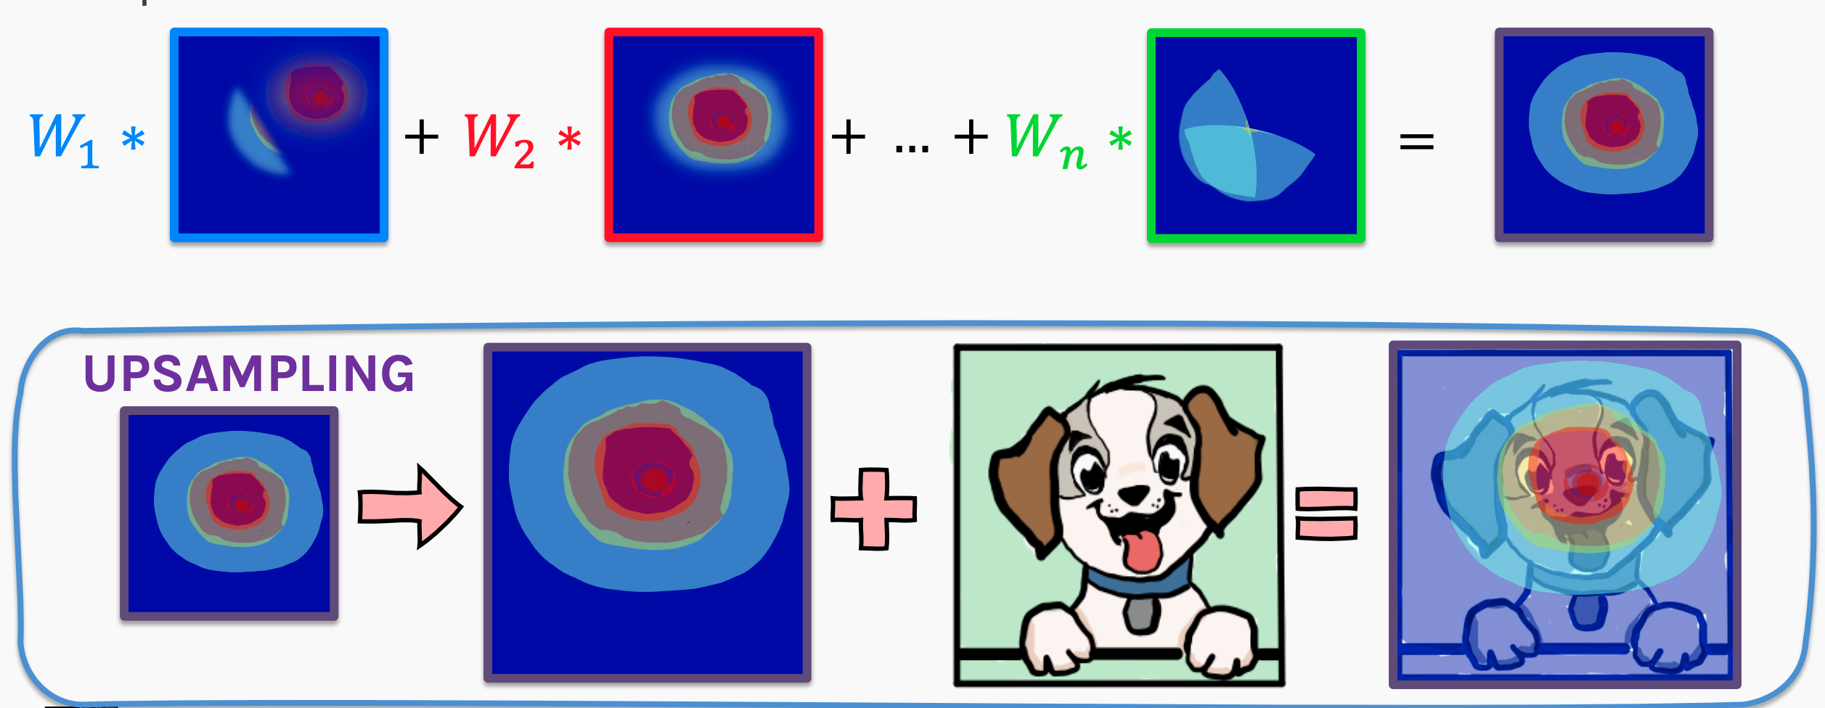
Class Activation Mapping (CAM)
Upsample the weighted feature map to the image dimensions to get the output
Notes:
A method to estimate which sub-part of the image the model focuses at when making a particular prediction. For example, Dog in the above image.

Slide 37
Class Activation Mapping (CAM)
Grad-CAM: is a more versatile version of CAM that can produce visual explanations for any arbitrary CNN, even if the network contains a stack of fully connected layers as well (e.g. the VGG networks)
Guided Grad-CAM: by adding an element-wise multiplication of guided-backpropagation visualization.
Notes:
The basic idea behind Grad-CAM is the same as the basic idea behind CAM: we want to exploit the spatial information that is preserved through convolutional layers, in order to understand which parts of an input image were important for a classification decision.
Grad-CAM is applied to a neural network that is done training; in other words, the weights of the neural network are fixed. We feed an image into the network to calculate the Grad-CAM heatmap for that image for a chosen class of interest.
Both CAM and Grad-CAM are local backpropagation-based interpretation methods. They are model-specific as they can be used exclusively for interpretation of convolutional neural networks.

Slide 38
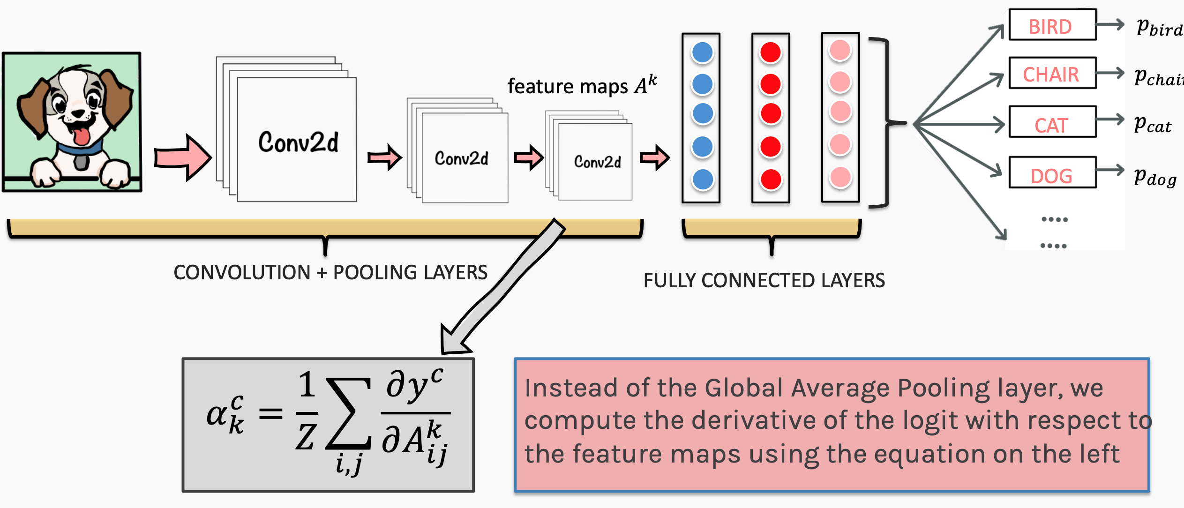
Class Activation Mapping (CAM)
Notes:
The basic idea behind Grad-CAM is the same as the basic idea behind CAM: we want to exploit the spatial information that is preserved through convolutional layers, in order to understand which parts of an input image were important for a classification decision.
Grad-CAM is applied to a neural network that is done training; in other words, the weights of the neural network are fixed. We feed an image into the network to calculate the Grad-CAM heatmap for that image for a chosen class of interest.
Both CAM and Grad-CAM are local backpropagation-based interpretation methods. They are model-specific as they can be used exclusively for interpretation of convolutional neural networks.

Slide 39
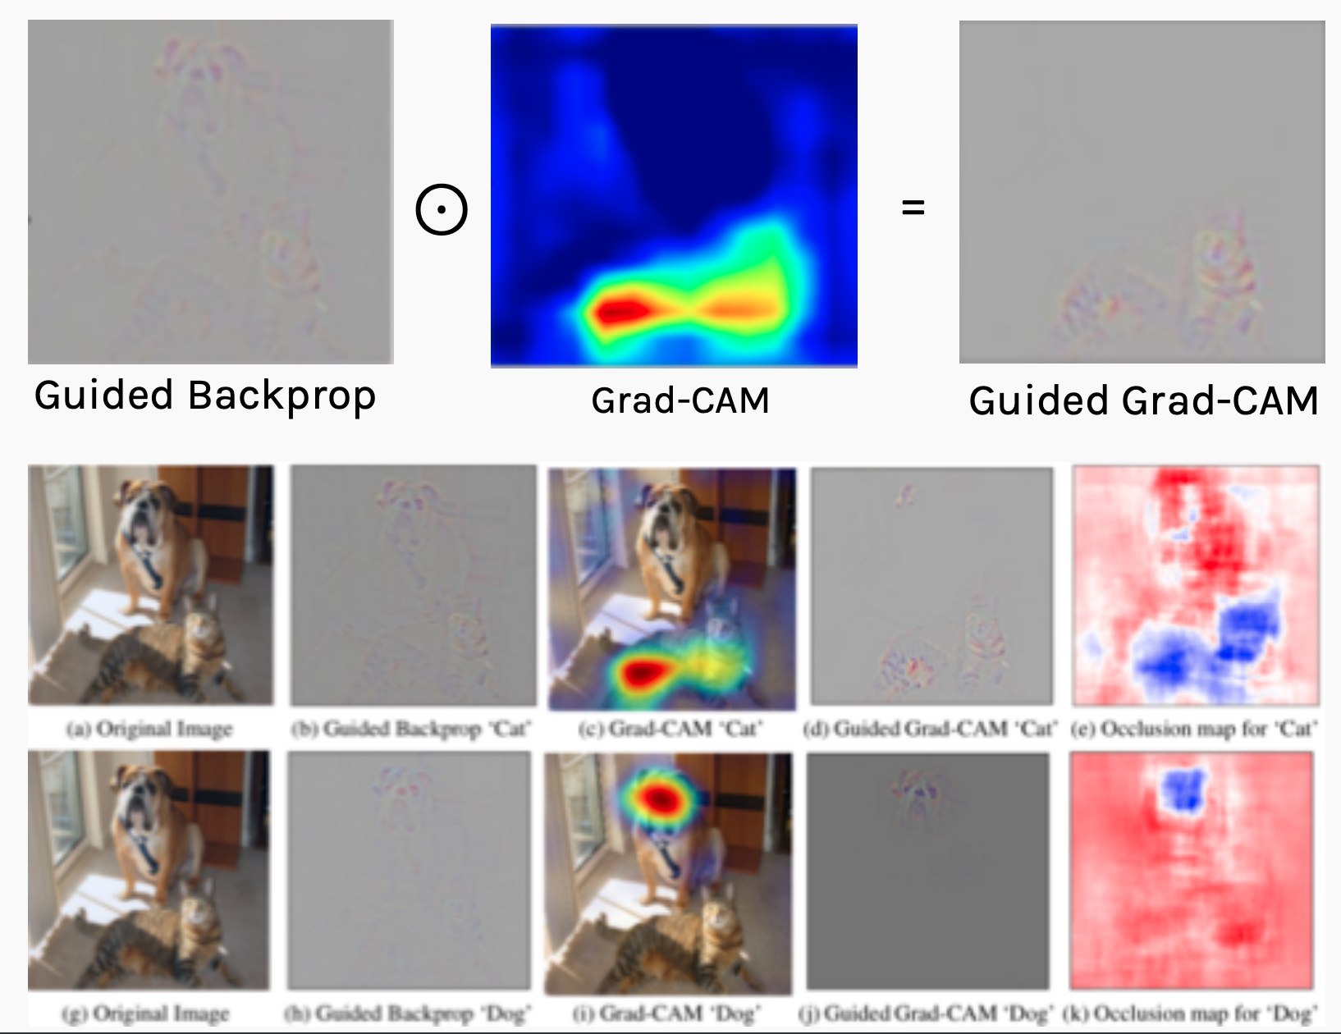
Class Activation Mapping (CAM)
Notes:
Grad-CAM can only produce coarse-grained visualizations.
Guided Grad-CAM combines GuidedBackpropagation with Grad-CAM by simply perform an elementwise multiplication of GuidedBackpropagation with Grad-CAM.

Slide 40
Class Activation Mapping (CAM)
Limitations:
Saliency maps are not always reliable. Indeed, subtracting the mean and normalizations, can make undesirable changes in saliency maps
Saliency maps are vulnerable to adversarial attacks
Notes:
Grad-CAM can only produce coarse-grained visualizations.
Guided Grad-CAM combines GuidedBackpropagation with Grad-CAM by simply perform an elementwise multiplication of GuidedBackpropagation with Grad-CAM.

